Slide 1







TECH-TREND & JOBS
HARVINDER SINGH
10TH MAY 2024

Slide 2



OUTLINE
Executive Summary
Introduction
Methodology
Results
Visualization – Charts
Dashboard
Discussion
Findings & Implications
Conclusion
Appendix

Slide 3

EXECUTIVE SUMMARY
• Current Technology Usage Trend
• Language
• Database
• Platform
• Web frame
• Future Technology Trend
• Language
• Database
• Platform
• Web frame
• Demographics Survey
• Country & Gender Difference

Slide 4

INTRODUCTION
• Analyze technology trend in software and web development among developers around the world
• Purpose of this Analysis
• Identify the top programming languages, database, platform and web frame skills in demand • Identify skill requirements for future
• Identify human resource gap in the industry
• Audience for this Presentation
• Programmers
• IT industry leaders
• Computer science students

Slide 5

METHODOLOGY
DATA COLLECTION(Sources)
• Stack overflow developer 2019 survey
• GitHub job postings
• Programming languages annual salary
DATA WRANGLING
DATA EXPLORATION
DATA CLEANING
DATA VISUALISATION
COGNOS
PYTHON

Slide 6
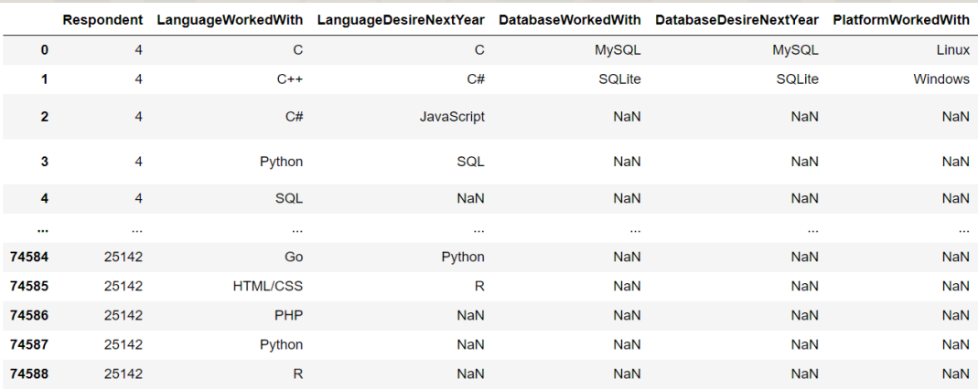
RESULTS

Slide 7
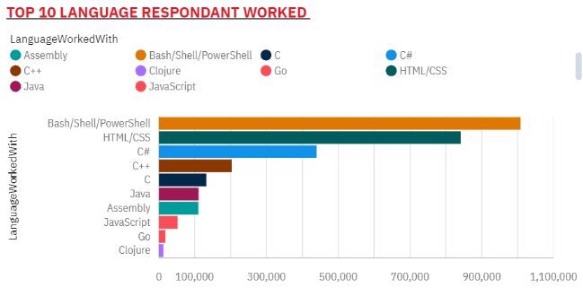
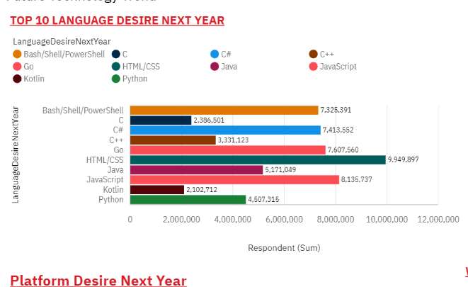
PROGRAMMING LANGUAGE TRENDS
Current Year
Next Year
<Bar chart of top 10 programming languages for the current year goes here.>
< Bar chart of top 10 programming languages for the next year goes here.>

Slide 8
PROGRAMMING LANGUAGE TRENDS - FINDINGS & IMPLICATIONS
Findings-
• JavaScript is top trending language in the world
• Python and TypeScript are becoming more and more popular • HTML/CSS and SQL still has great portion in language usage trend
Implications-
• Web developments and Web developers are still in high demands
• JavaScript and TypeScript are crucial to learn for developers
• Python is the new trending language, especially popular in AI fields

Slide 9
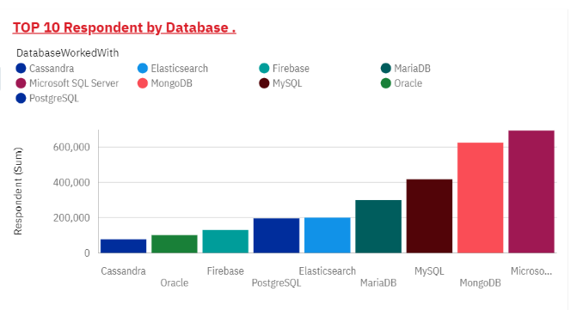
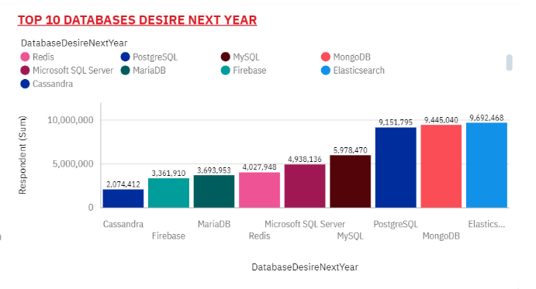
DATABASE TRENDS
Current Year
Next Year
< Bar chart of top 10 databases for the current year goes here >
< Bar chart of top 10 databases for the next year goes here.>

Slide 10
DATABASE TRENDS - FINDINGS & IMPLICATIONS
Findings-
• MySQL is the most popular database
• There are still a lot of companies using Microsoft SQL Server
• MongoDB and Redis are the most favorable NoSQL database
Implications
ELASTICSEARCH would be most preferred database.
MongoDB and POSTGRESQL would be in high demands.

Slide 11

DASHBOARD
https://github.com/Harvinder1594/IBM-CAPSTONE-PROJECT/blob/d267b7539aaaac0b56a019afb31ac06e1e366250/m5.pdf

Slide 12
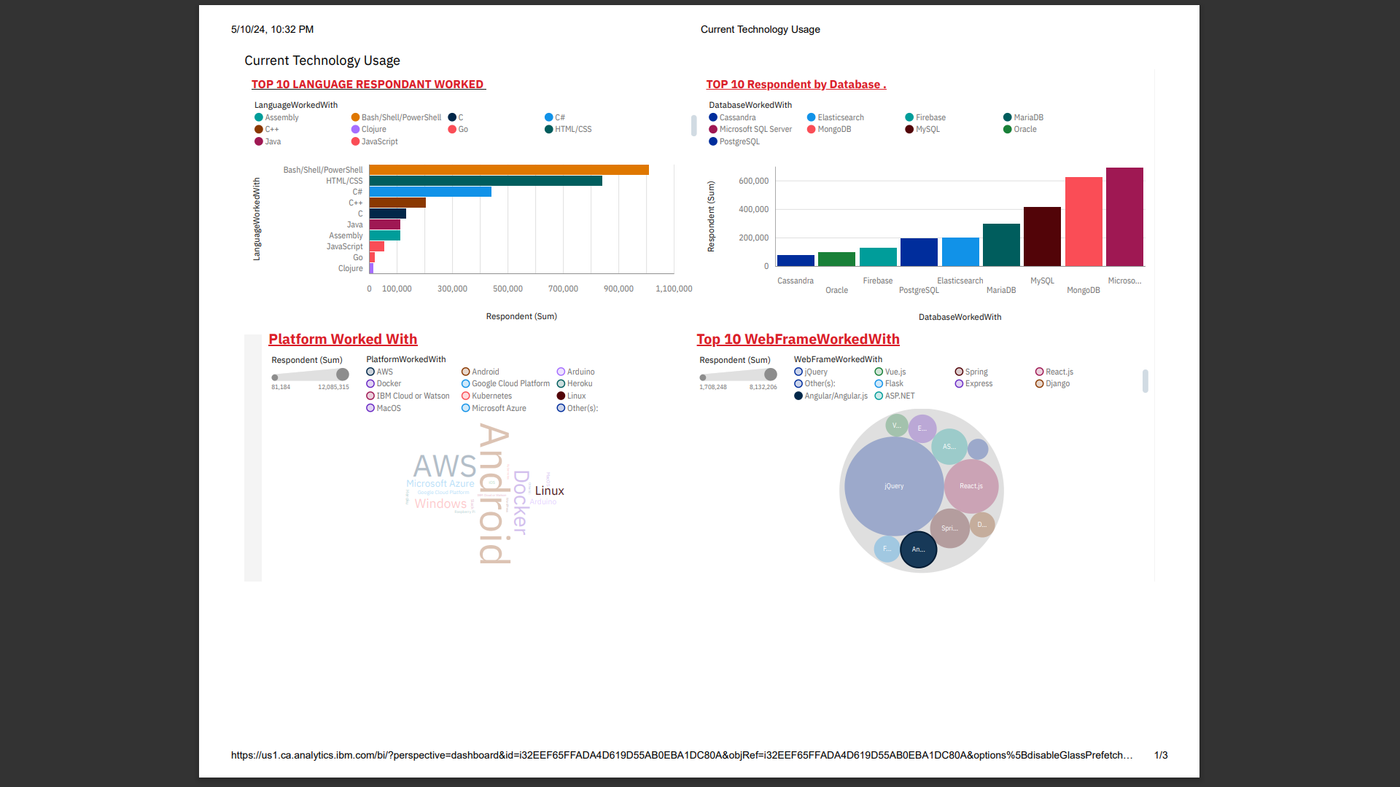
DASHBOARD TAB 1
Screenshot of dashboard tab 1 goes here

Slide 13
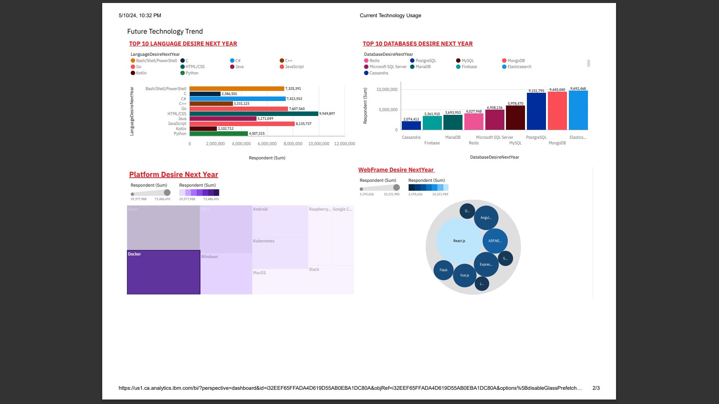
DASHBOARD TAB 2
Screenshot of dashboard tab 2 goes here

Slide 14
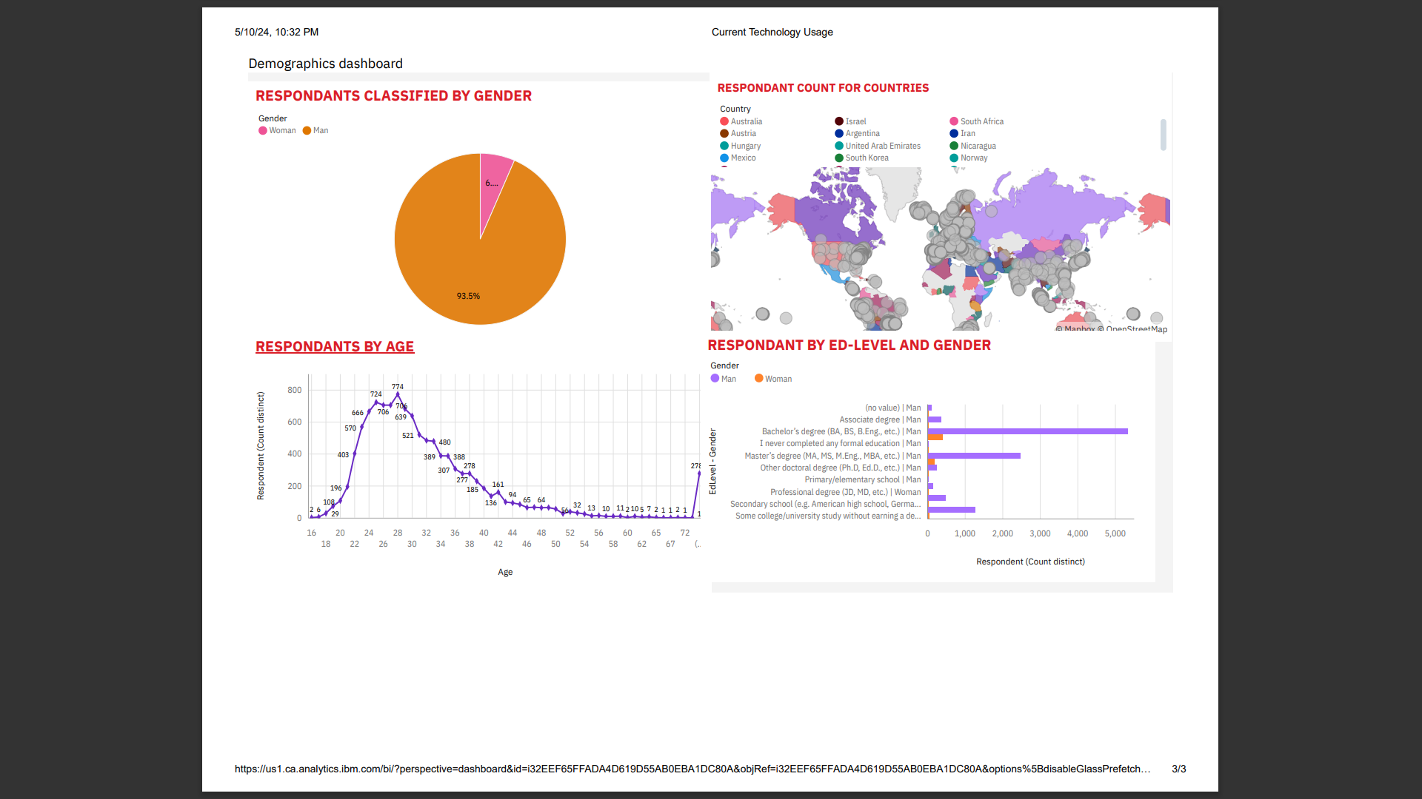
DASHBOARD TAB 3
Screenshot of dashboard tab 3 goes here

Slide 15
DISCUSSION
• Technology Usage Trend Now and Future
• Gender, Age and Education Discrimination in IT Industry

Slide 16
OVERALL FINDINGS & IMPLICATIONS
Findings
• Technology trends changes every year
• USA is the top technology country
• There are extreme gender and age discrimination
Implications
• Programmers should always follow the latest technology trends .
• More countries should have the equal chance to be exposed to new technology .
• Gender and Age should not be one of the concerns or benefits of Employment.

Slide 17

CONCLUSION
• Technology Trends
• Programming Languages, Database, Platform and Web frame Trends
• Demographics Trends
• Gender and Education
• Programming Languages Trends and Salary Trends

Slide 18

APPENDIX
• IBM Cognos Dashboard Embedded (CDE) is an AI-fueled business intelligence service that supports the entire data analytics cycle, from discovery to operationalization. It provides users with data discovery capabilities to visually explore and interact with their data to identify the key insights for improving data driven decisions. Users can perform data discovery and then quickly assemble that information into interactive, visually appealing dashboards; all without the need of formal training.

Slide 19
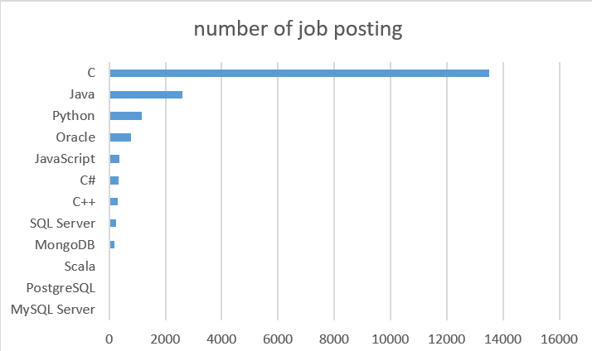
JOB POSTINGS
In Module 1 you have collected the job posting data using Job API in a file named “job-postings.xlsx”. Present that data using a bar chart here. Order the bar chart in the descending order of the number of job postings.

Slide 20
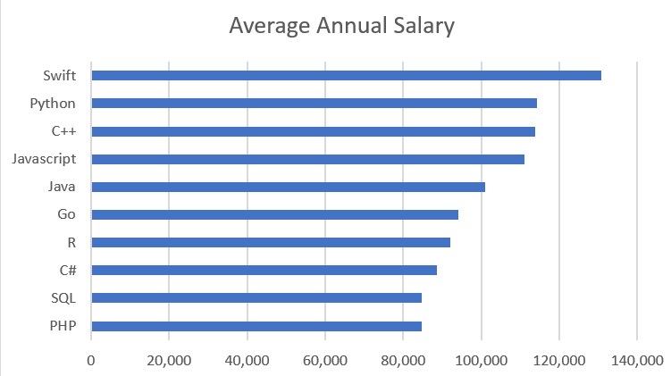
POPULAR LANGUAGES
In Module 1 you have collected the job postings data using web scraping in a file named “popular-languages.csv”. Present that data using a bar chart here. Order the bar chart in the descending order of salary.

